Slide 1
Roger Johansson
Creator of:
Proto.Actor
Akka .NET
TraceLens
Company: Asynkron
Twitter: @rogeralsing
Github: rogeralsing
Mail: roger@asynkron.se

Slide 2
Scaling up and out with

Slide 3
Agenda Day 1
What is the Actor Model?
Local Actors
Create your first actor
Props, PIDs
Actor interface, Func Actor
Messages - importance of immutability
Messaging
Send vs Request vs RequestFuture vs Forward
Futures
Await vs Reenter

Slide 4
Agenda Day 1
Local Actors
Fault Tolerance and Supervision and the ”Let it crash”-model
OneForOne
AlwaysRestart
Exponential Backoff
Behaviors
Become/Unbecome
Building Protocols

Slide 5
Agenda Day 1
Local Actors
Routers
Group vs Pool routers
Why not actors?
Built in router types
Common use-cases
Middleware
Logging
Tracing
Persistence

Slide 6
Agenda Day 1
Local Actors
Common workload patterns
Throttling
Work-pulling pattern
Dropping mailbox

Slide 7
Agenda Day 1
Remote Actors
Location Transparency, Distributable by design
Set up a remote node
Serialization Json vs Protobuf
Walkthrough Chat example
Remote Kinds, Remote Spawn

Slide 8
Proto.Actor
Next Generation Actor Model:
Built on standards – Protobuf, gRPC Streams, Consul/Kubernetes
Platform independent – C#, Go
Actors and Virtual Actors – Unified model of Akka and Project Orleans
Ultra fast – 65 times faster than Akka.NET over network

Slide 9

Actor Model
A programming paradigm

Slide 10
Actor Model
Three axioms:
Send – an actor can send messages to other actors
Spawn – an actor can spawn new actors
Become – an actor can decide how to handle it’s next message

Slide 11
Actor Model
”An island of consistency in a sea of concurrency”
”Shared nothing”, ”Black box”
”Location transparent”, ”Distributable by design”

Slide 12
Actor Model
BEAM – Erlang, Elixir, LFE
JVM – Akka, Orbit
.NET – Akka.NET, Proto.Actor, Project Orleans
Go – Proto.Actor

Slide 13
OOP vs. Actor Model
OOP
Actor Model
Behavior
Behavior
Stateful
Stateful
Synchronous method calls
Asynchronous message passing

Slide 14

Scale Up

Slide 15
Multi-Core programming?
Go
Goroutines
Channels
WaitGroups
…
.NET
TPL Tasks / Dataflow
Threads
Channels
…

Slide 16
What happens when you cannot
scale up any more?

Slide 17
Scale Out

Slide 18
How do you scale out?
Services, HTTP or gRPC
Queues and logs, Rabbit MQ or Kafka
…

Slide 19
We have different tools for scaling up and out.
An HTTP API has very little in common with a Goroutine.
You have to make decisions upfront on how to design your system

Slide 20
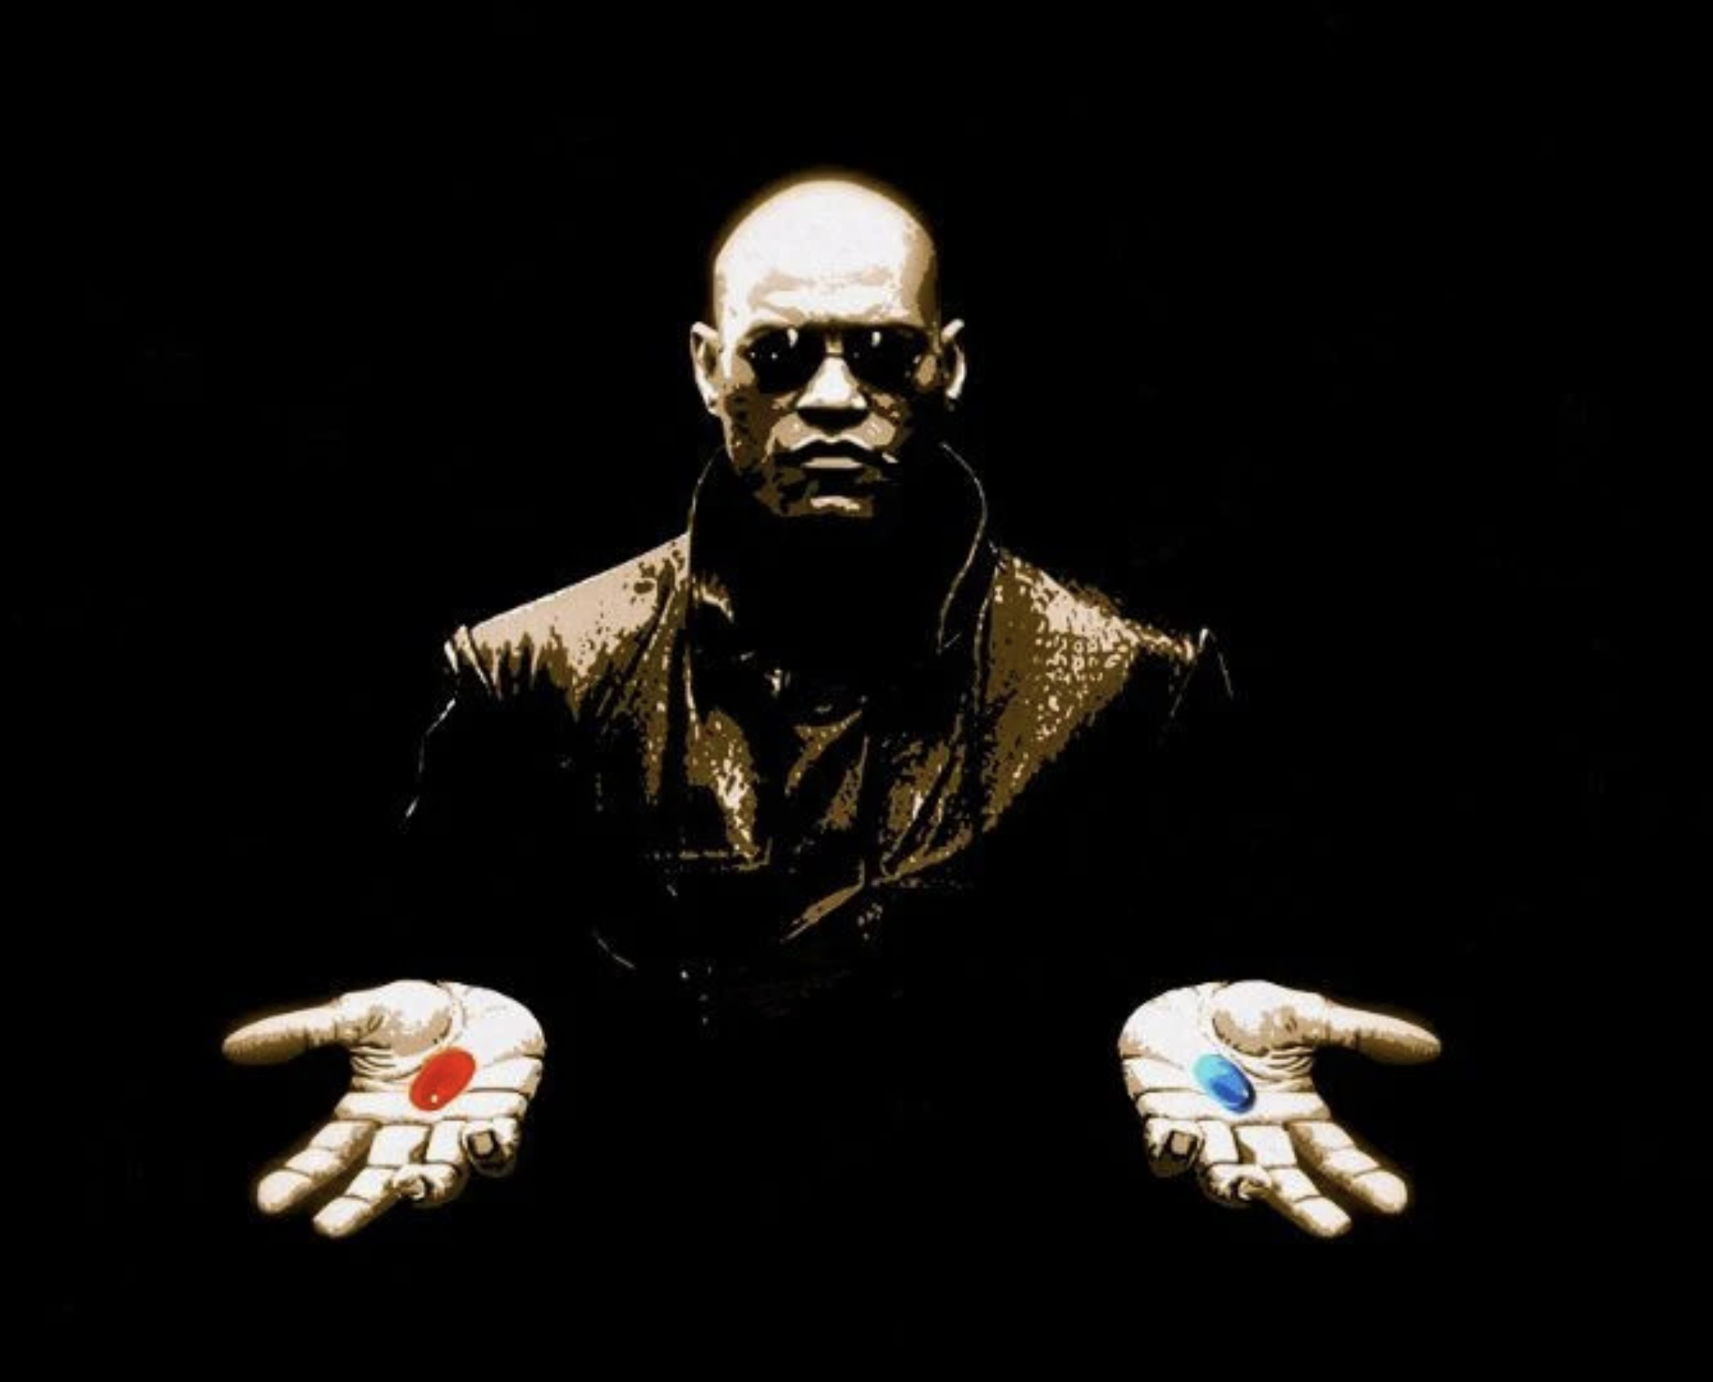
What if I told you…

Slide 21
Scale up and out, are essentially the same
That is; We want to execute code ”somewhere”, on a core, on a machine, in a cluster.
Why should we as developers have to resort to different technologies to do the same thing?

Slide 22
Event-driven thread
Actor
Mailbox
Transport
PID
Behavior
State
Supervision
Children

Slide 23
Hello World Demo

Slide 24
Messaging
Tell vs Ask, Push vs Pull
Messaging durability
Send vs Request vs RequestFuture vs Forward

Slide 25
Messaging
Send
Fire and Forget.
At most once delivery
A
B
Might or might not arrive here

Slide 26
Messaging
Manual Requests
Zero overhead, just messaging
Pass a PID as part of the message
A
B
You need to handle the response as a message
Send response back to PID

Slide 27
Messaging
Context.Request
(Almost) Zero overhead
Special envelope message
User message is wrapped in Envelope
A
B
You need to handle the response as a message
Send response back to ”Sender” PID

Slide 28
Messaging
Context.RequestFuture
Allocates a Temp Actor (Future)
Special envelope message
Envelope message,
”Sender” is PID of Future
A
B
A’s mailbox will be blocked while waiting for result
Send response back to ”Sender” PID
Future

Slide 29
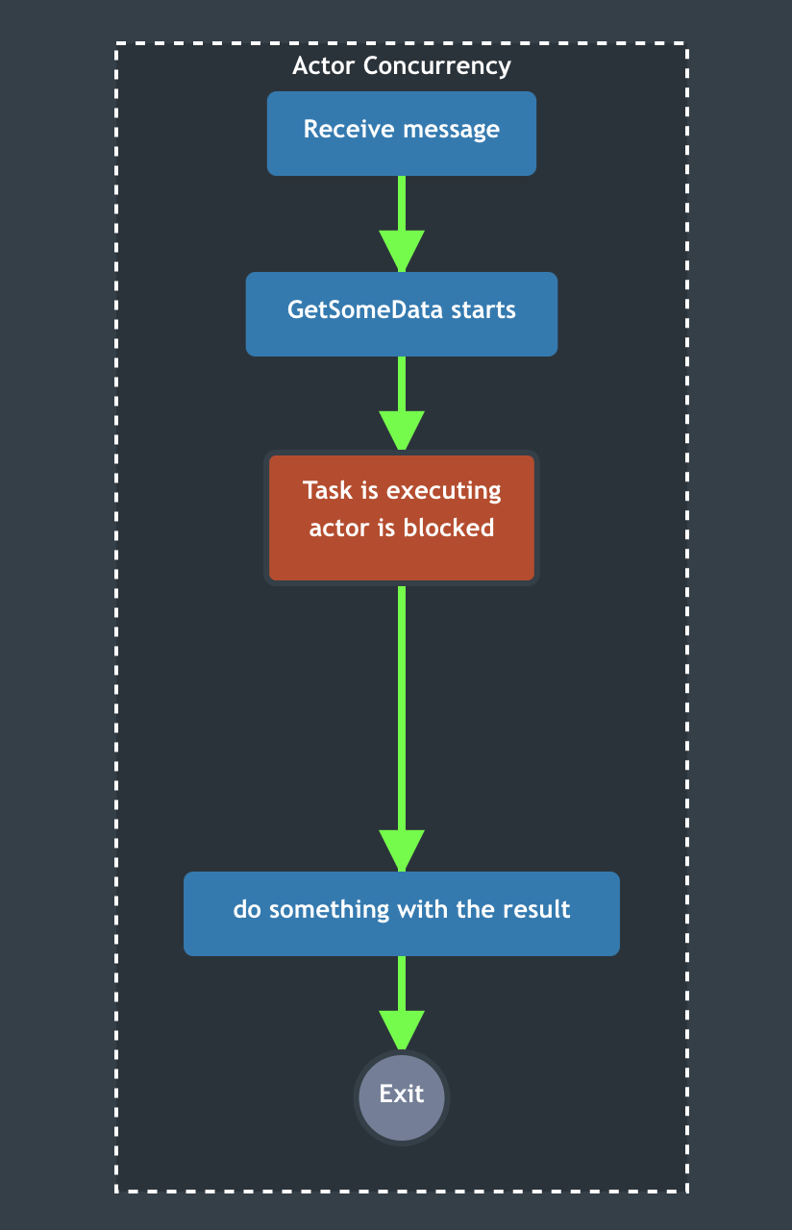

Slide 30
Messaging
Context.ReenterAfter
Allocates a Temp Actor (Future)
Special envelope message
Envelope message,
”Sender” is PID of Future
A
B
Mailbox is not blocked
Send response back to ”Sender” PID
Future

Slide 31
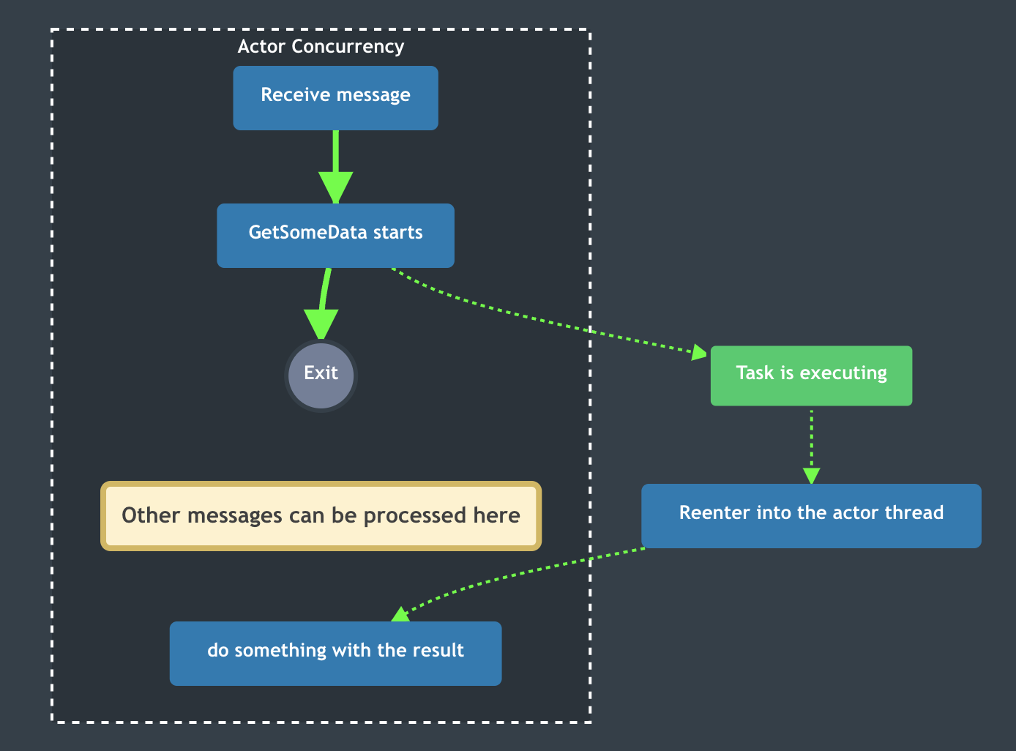

Slide 32
Messaging
B ”Forwards” to C
Preserving A as Sender
Context.Forward
Propagates Message and Sender
B
A
C

Slide 33
Messaging
Push vs Pull.
Prefer Push instead of Pull.
If something happens in B, push an event to A, so that A already have the answer.
Whenever A needs the answer, it already has it, which is 0 latency
A
B
A
B

Slide 34
Aggregating Hierarchical Data
Global
Aggregate data by pulling?
Country 1
Country 2
Org 1
Org 2
Driver 1
Driver 2
Driver 3
Driver 4
Driver 5

Slide 35
Aggregating Hierarchical Data
Global
Push data upwards
Country 1
Country 2
Org 1
Org 2
Driver 1
Driver 2
Driver 3
Driver 4
Driver 5

Slide 36
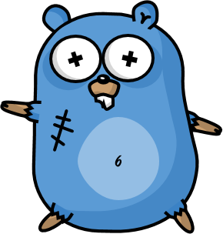
Design for failure
The famous Erlang 99.9999999% uptime

Slide 37
Let it crash
Protect state by delegating work
parent
Performs work, can be restarted
child

Slide 38
Website
Businesslogic
Data Access

Slide 39
Service Technician
Out of beans
Refill beans
Insert coins
Me
Vendor machine
Need more coins
Out of beans!
Gets coffee

Slide 40
Supervisor
Application error
Manage failures
Request
Client
Service
Validation error
Response

Slide 41
Error Kernel
/
99.9999999% uptime ~0.03 sekunder downtime per år
OneForOne supervisor
/a1
/a2
AllForOne supervisor
/b1
/b1
/b2
/b3
/b3
/c1
/c2
/c3
/c4
/c5

Slide 42
Bulkheads

Slide 43
Supervision Demo

Slide 44
Behaviors
An actor can decide how to handle the next message

Slide 45
Behaviors
Imagine a game like World of Warcraft.
A character can be in different states.
e.g. Alive, Dead or even intoxicated.
While in these states, the character reacts differently to input.

Slide 46
Behavior Demo

Slide 47
Routers
A router is an ’actor-like’ object that can be used to route messages.
Routee1
4
3
2
1
Router
1
Routee2
Routee3
Forward to some target

Slide 48
Group Routers
Group router is used when you want to route to messages to a set of already existing actors.
Routee1
Router
Routee2
Routee3
You provide these

Slide 49
Pool Routers
Pool Routers are used when you just want to have a managed pool of workers.
Routee1
Router
Routee2
Routee3
The router provide these

Slide 50
Round Robin Routing
Round robin routing, as the name implies, allow you to pass messages in a round robin fashion to the target actors.
4
1
Routee1
Scale up!
4
3
2
1
Router
2
Routee2
.. Or down!
3
Routee3

Slide 51
Random Routing
For each message you send to the router, it will pick a random target to send the message to.
2
Routee1
4
3
2
1
Router
4
1
Routee2
3
Routee3
Random targets

Slide 52
Broadcast Routng
This router will send each message to all of the target actors.
Notifies all ”routees”
2
1
Routee1
2
1
Router
2
1
Routee2
2
1
Routee3

Slide 53
Consistent Hash Routing
This router will compute a hash from each message sent to it, and use this to select the target actor to send the message to.
A
M
Routee1
X
A
Y
M
Router
Y
Routee2
X
Routee3
Affinity between hash index and routee

Slide 54
Consistent Hash Routing
Maps hash of 123 to routee1
Id: 123
Id: 123
Stop
Create
Routee1
…
…
Id: 789
Id: 123
Id:456
Id: 123
Id:456
Router
Routee2
Payment
Stop
Create
Create
Create
…
…
…
…
…
Id: 789
Payment
Routee3
…

Slide 55
Router Demo

Slide 56
Middleware
There are two types of ”middleware” in Proto.Actor.
Receive Middleware and Send Middleware.
Actor
Receive
Send

Slide 57
Middleware
Open Tracing Middleware
Incoming, Message + Headers
Actor
Sender Middleware creates new headers when sending

Slide 58
Middleware
On this topic, see Greg Youngs presentation ”8 lines of code”
Message Handler
Receive
Send

Slide 59
Persistence
Proto.Actor Persistence, is based on the concepts from eventsourcing
Actor decides if message is persisted to DB
Actor
On start/restart, persisted messages are replayed to the actor

Slide 60
Patterns
Fan out – quickest reply
Send request to all targets
Fan out
?
Worker 1
Consumer
?
Router
?
Worker 2
?
Worker 3

Slide 61
Patterns
Use the first reply that comes back
Return first reply
!
Worker 1
Consumer
!
Router
!
Worker 2
!
Worker 3

Slide 62
Patterns
Use the first reply that comes back
Require same reply from at least N workers
!
Worker 1
Consumer
!
Router
!
Worker 2
!
Worker 3

Slide 63
Patterns
Throttling, the naive way
Add a delay after each message

Slide 64
Patterns
Throttling, a better way
Limit messages per time slice

Slide 65
Patterns
Bounded Mailbox
Mailbox
Actor

Slide 66
Patterns
Bounded Mailbox
Mailbox
Actor

Slide 67
Patterns
Work pulling pattern
Producer
Send work
Worker 1
Work to be done
Work Done
Send work
Worker 2
Work to be done
Work Done

Slide 68
Exponential Backoff
parent
Delay
child
Attempts

Slide 69
Circuit Breaker
DB Actor
DB Query
DB Up
DB Result
DB Query
DB Down
DB Error

Slide 70

Remote Actors
Distributable by design

Slide 71
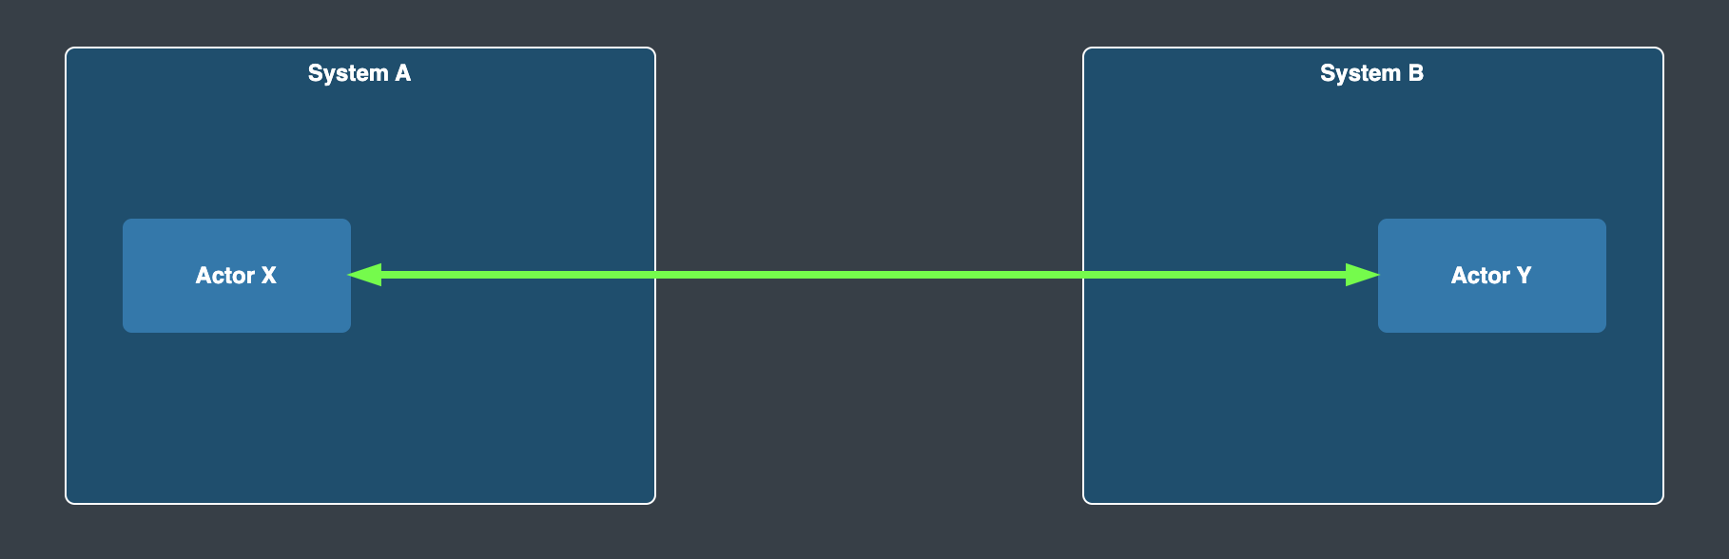

Slide 72
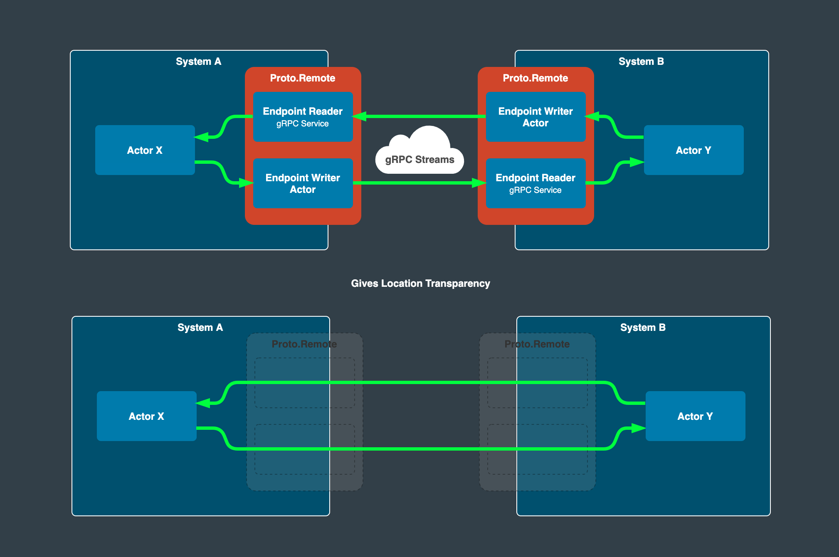

Slide 74
Chat Demo

Slide 75
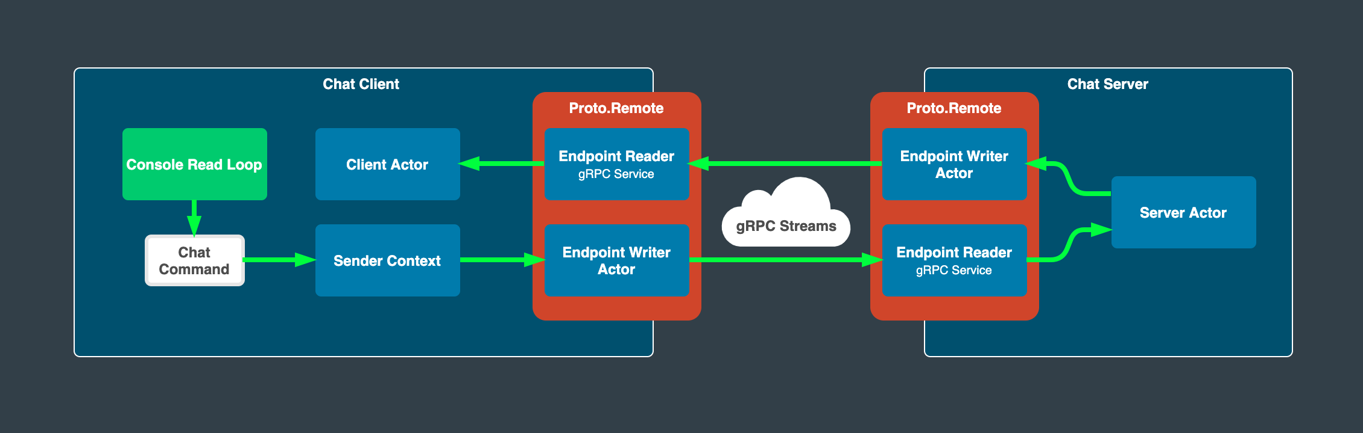

Slide 76
Remote Spawn Demo

Slide 77
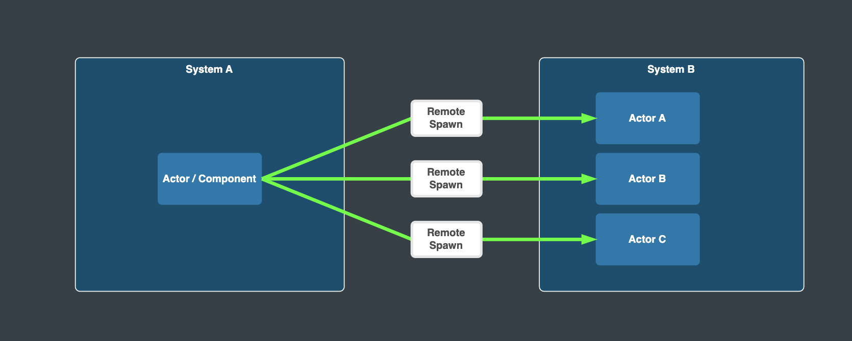

Slide 78
Virtual Actors
Always Exists, Never Fails

Slide 79
Virtual Actors
Virtual actors are:
Virtually always existing
Addressed via ”Identity” and ”Kind”
Request Response driven
Built ontop of plain actors

Slide 80
This is a ”Cluster” of nodes
They are all connected to each other via Proto.Remote
They see/find each other using a ”Cluster Provider”, e.g. Consul, Kubernetes
Node 1
Node 2
Node 3
Node 4
Node …

Slide 81
This is a ”Cluster” of nodes
They are all connected to each other via Proto.Remote
They see/find each other using a ”Cluster Provider”, e.g. Consul, Kubernetes
Node 1
Node 2
Node 3
Node 4
Node …
Cluster Provider

Slide 82
This is a ”Cluster” of nodes
They are all connected to each other via Proto.Remote
They see/find each other using a ”Cluster Provider”, e.g. Consul, Kubernetes
Node 1
Node 2
Node 3
Node 4
Node …
I see the following nodes:
Node 1, 2, 3, 4, 5
Cluster Provider

Slide 83
Virtual Actor ID
ID Hash
ID Owners
Node 1
Node 2
Node 3
Node 4
Node …
Actor Placement
Node 1
Node 2
Node 3
Node 4
Node …

Slide 84
Virtual Actor ID
ID Hash
Distributed Hashtable
Key
ID Owners
Node 1
Node 2
Node 3
Node 4
Node …
Rendezvous
Algorithm
Value
Actor Placement
Node 1
Node 2
Node 3
Node 4
Node …

Slide 85
Virtual Actor ID
ID Hash
Actor Placement
Node 1
Node 2
Node 3
Node 4
Node …

Slide 86
Virtual Actors
SomeId124 + Kind
SomeId123 + Kind

Slide 87
Virtual Actors

Slide 88

Realtime Map
Asset Actor
User Viewport
MQTT
Realtime Map

Slide 89
Challenges and solutions,
Dealing with stream processing at scale

Slide 90
Challenge: Avoid excessive DB reads
Where is ”source of truth?”

Slide 91

Request
Request
Request
Read
Write
Read
Write
Read
Write
Stateless Service
Source of truth

Slide 92
Request
Request
Request
Write
Write
Write
Stateful Actor
Source of truth
Never interact with the DB from elsewhere

Slide 93

Request
Request
Request
Write
Write
Write
Stateful Actor
Source of truth

Slide 94
Challenge: Avoid excessive DB writes

Slide 95
Request
Request
Request
Write
Stateful Actor

Slide 96
Request
Request
Request
Write
Stateful Actor

Slide 97
Solution: Envelope Pattern

Slide 98
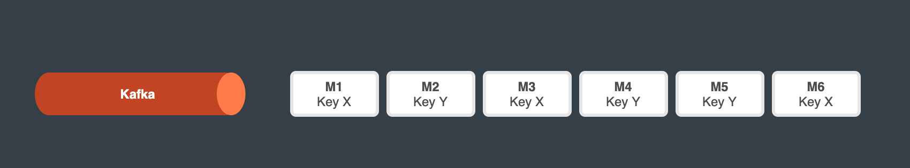

Slide 99
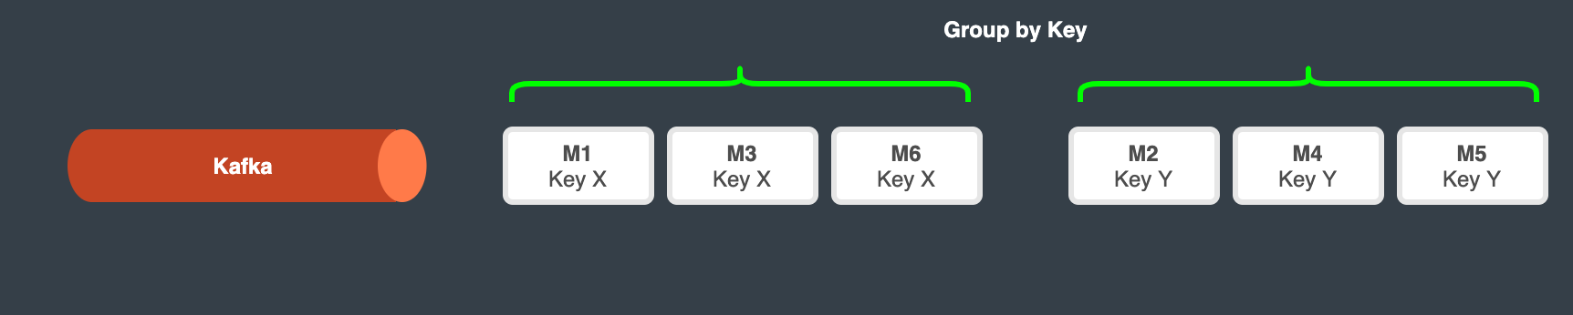

Slide 100
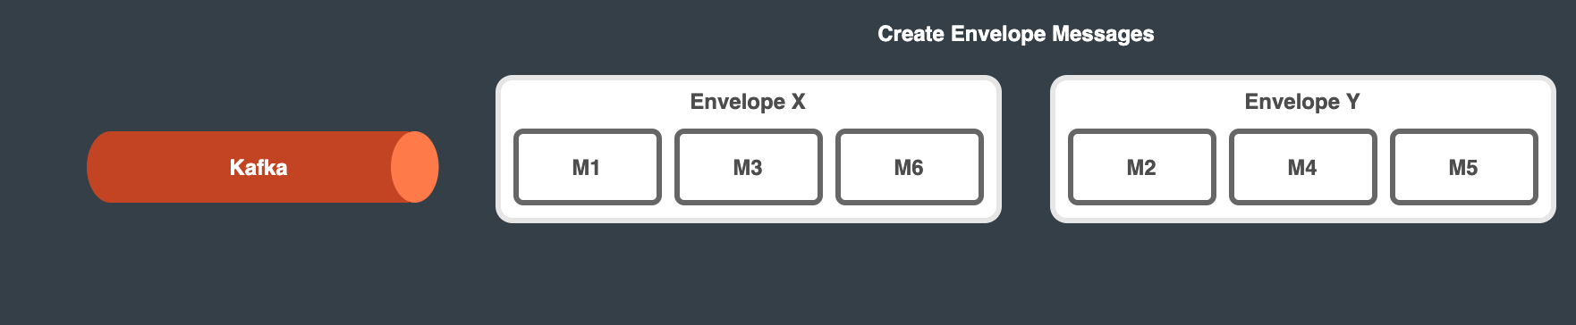

Slide 101
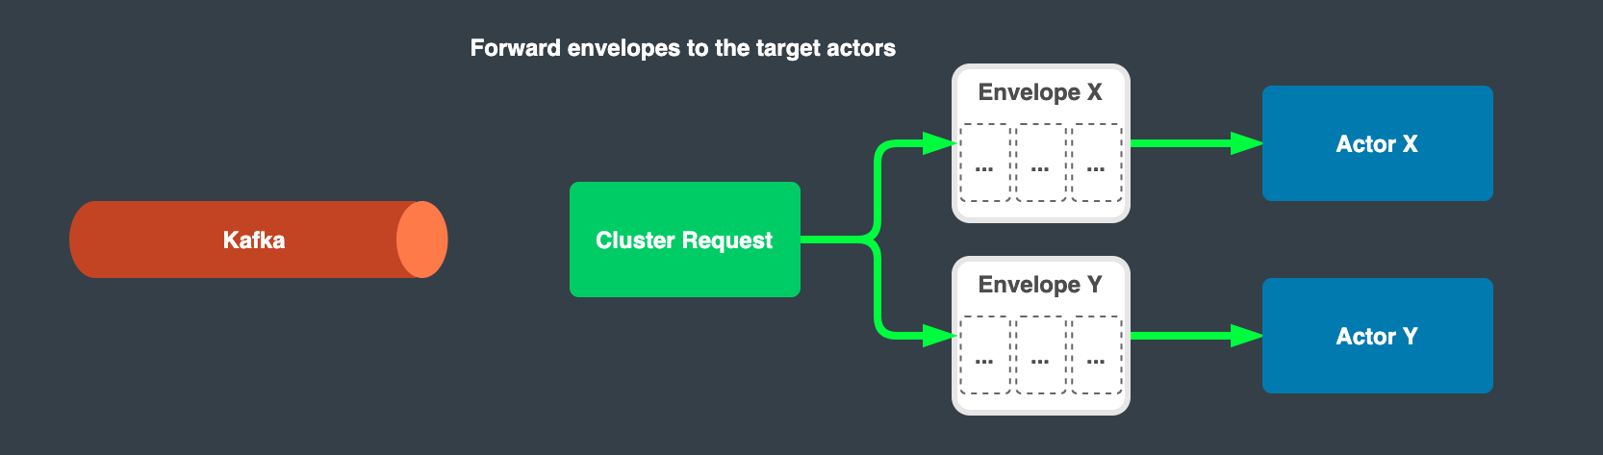

Slide 102
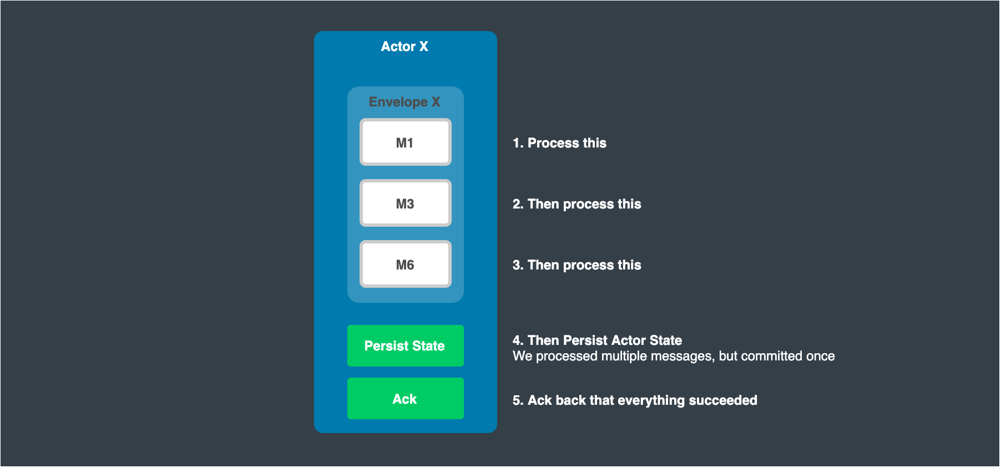

Slide 103
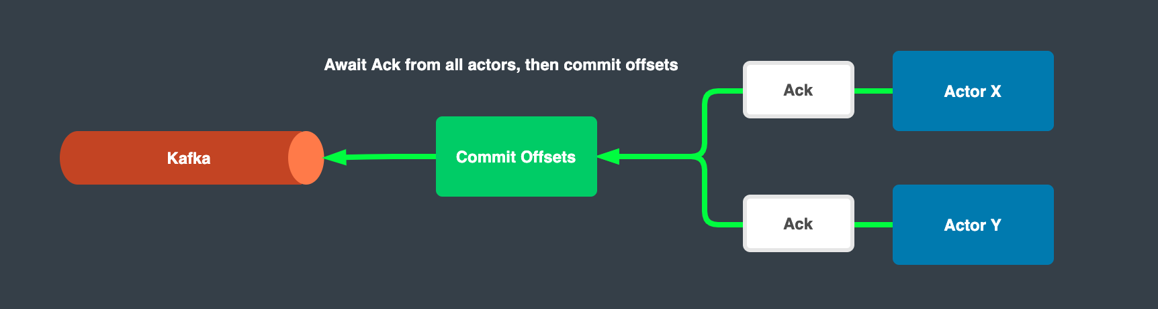

Slide 104
Challenge: Concurrency management

Slide 105
Process many messages for different entities in parallel

Slide 106
Process many messages for different entities in parallel
1
2
3

Slide 107
Process many messages for different entities in parallel
1
2
Process one message at a time per entity
3

Slide 108
Challenge: Avoid network hops

Slide 109
Kafka

Slide 110
Kafka

Slide 111
Solution: Local Affinity

Slide 112
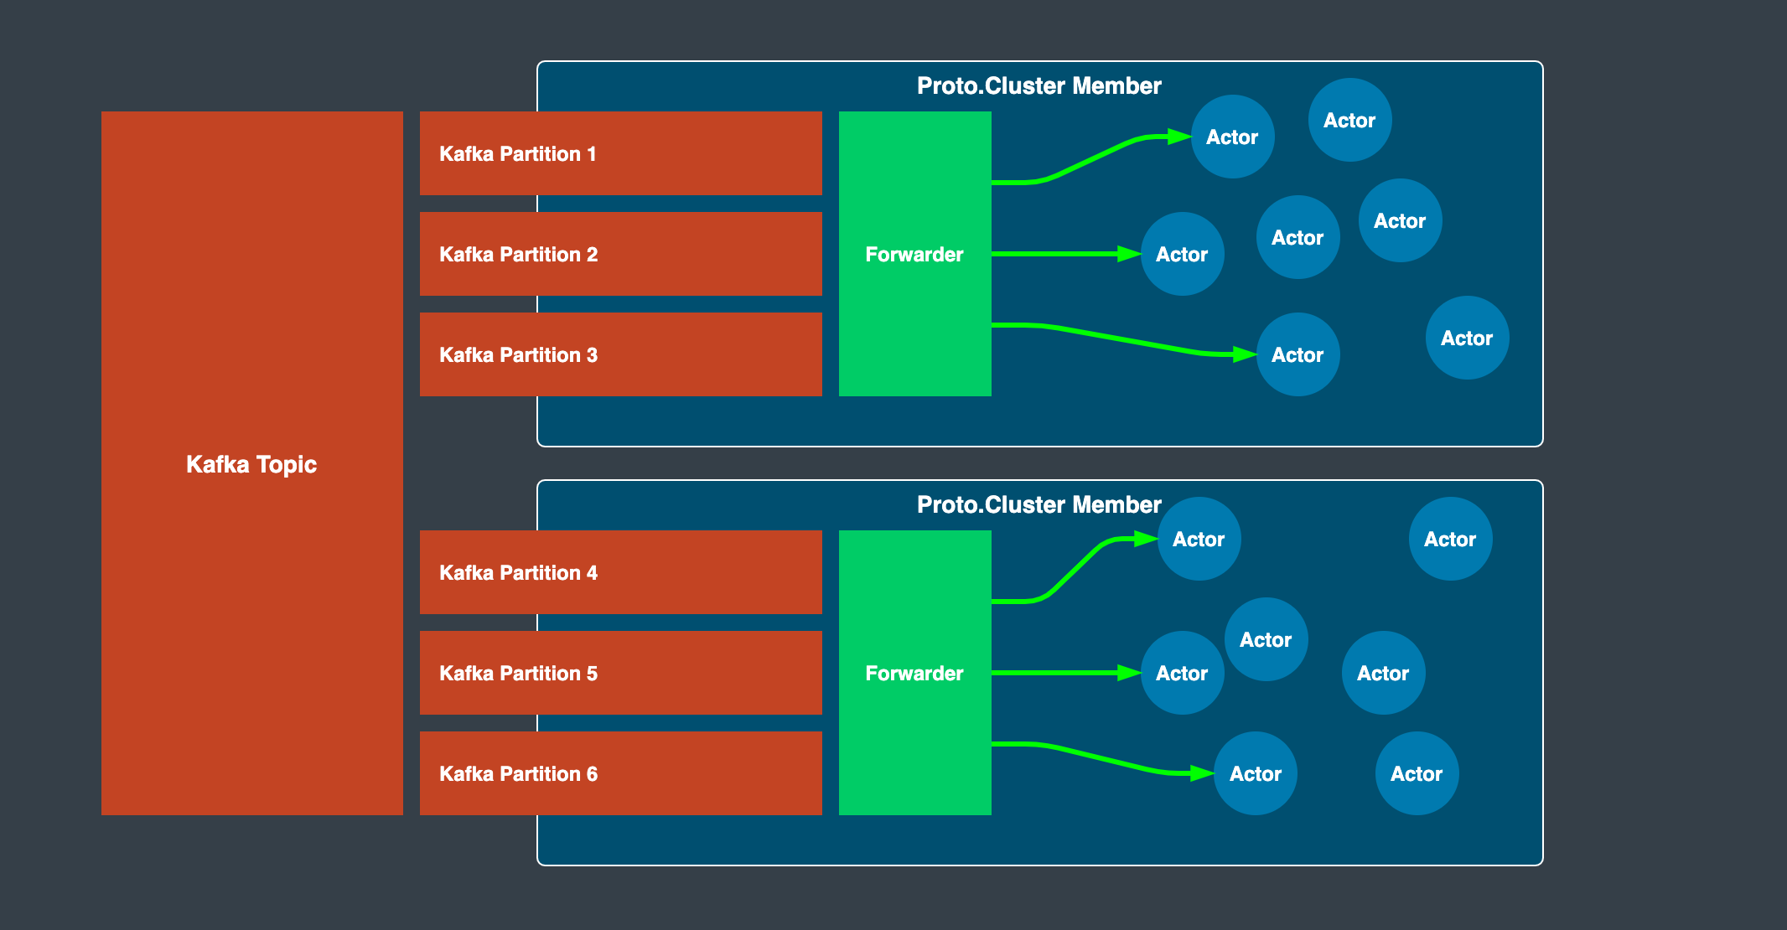

Slide 113
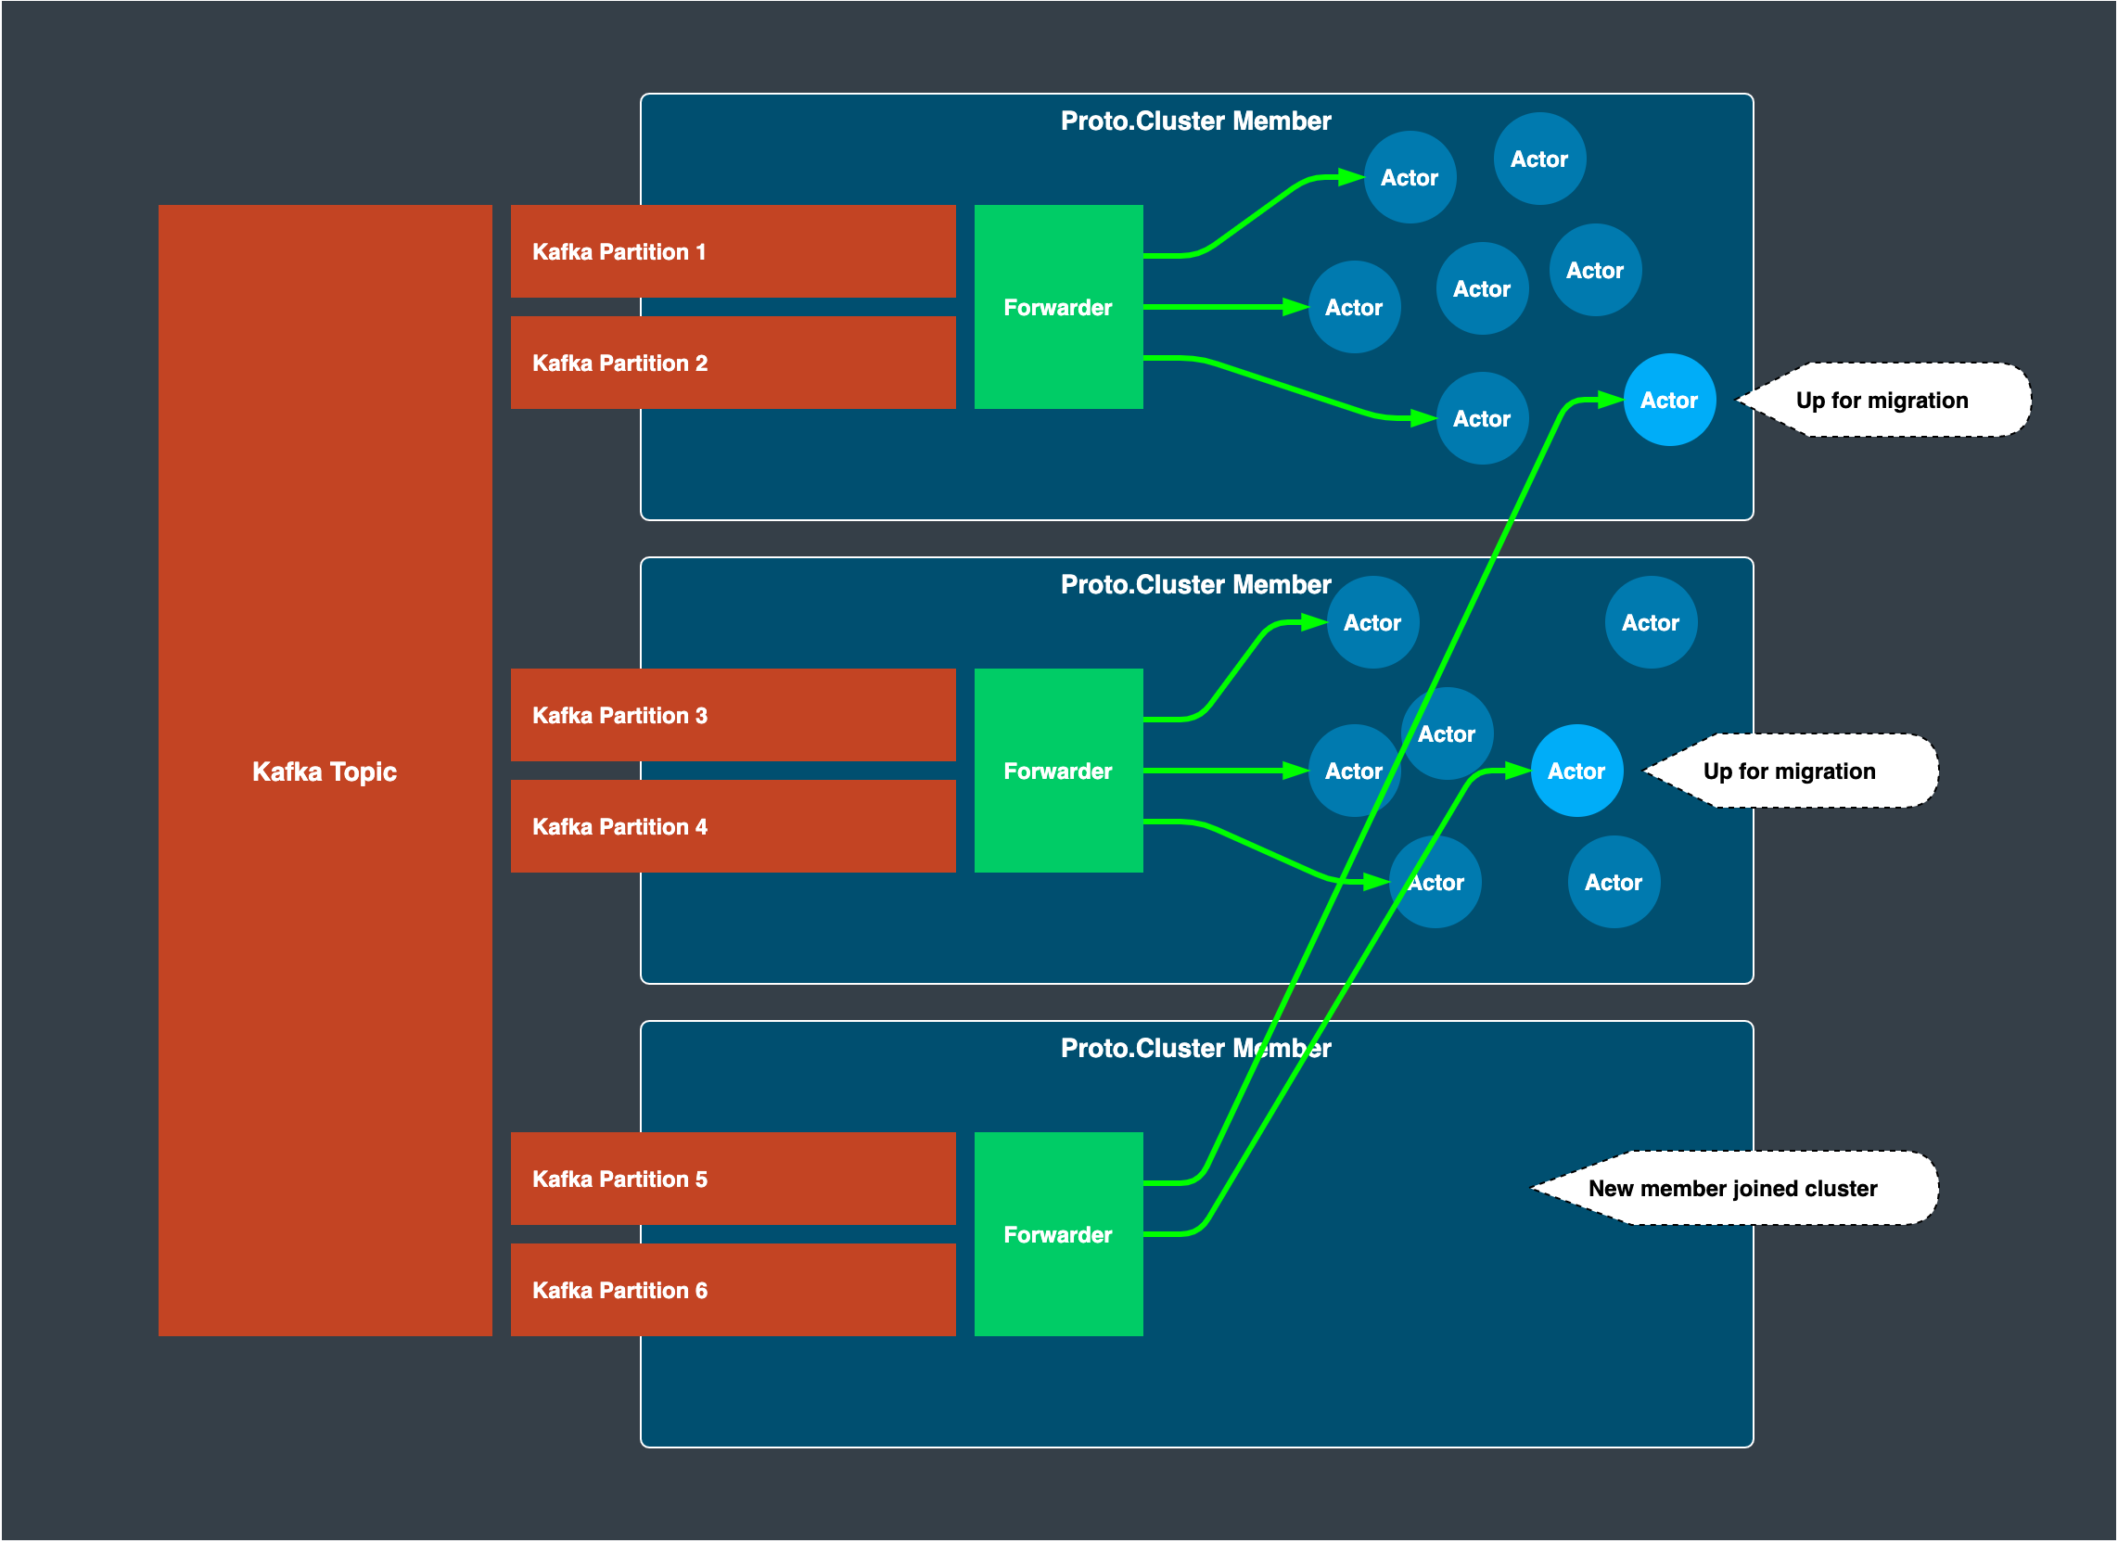

Slide 114
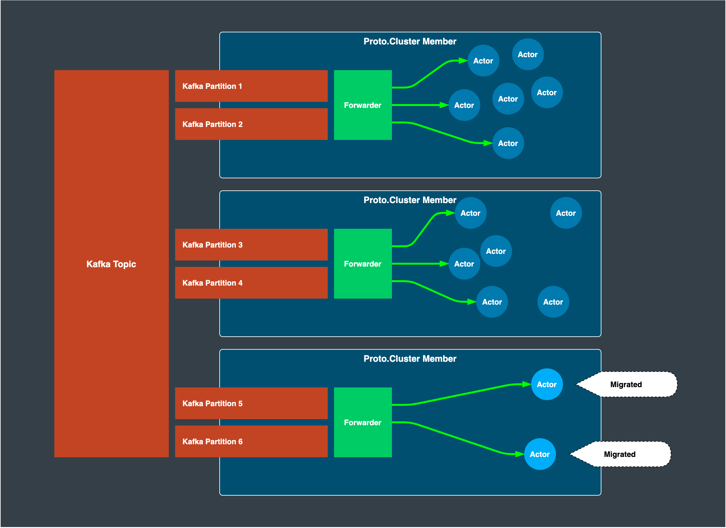

Slide 115
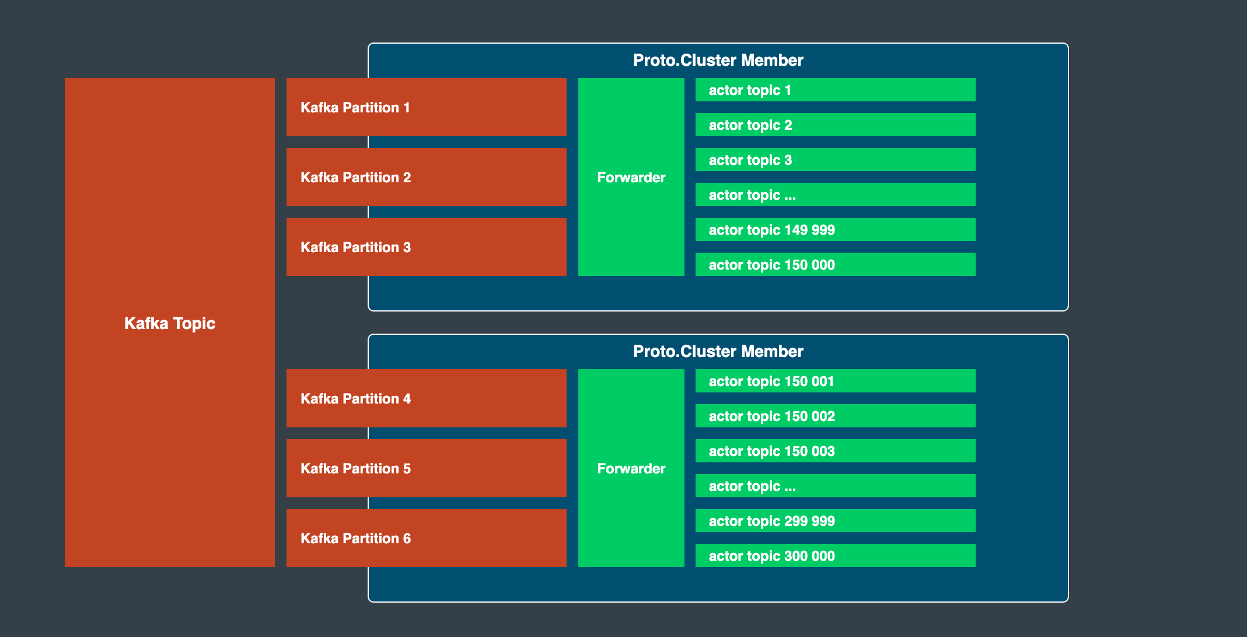

Slide 116
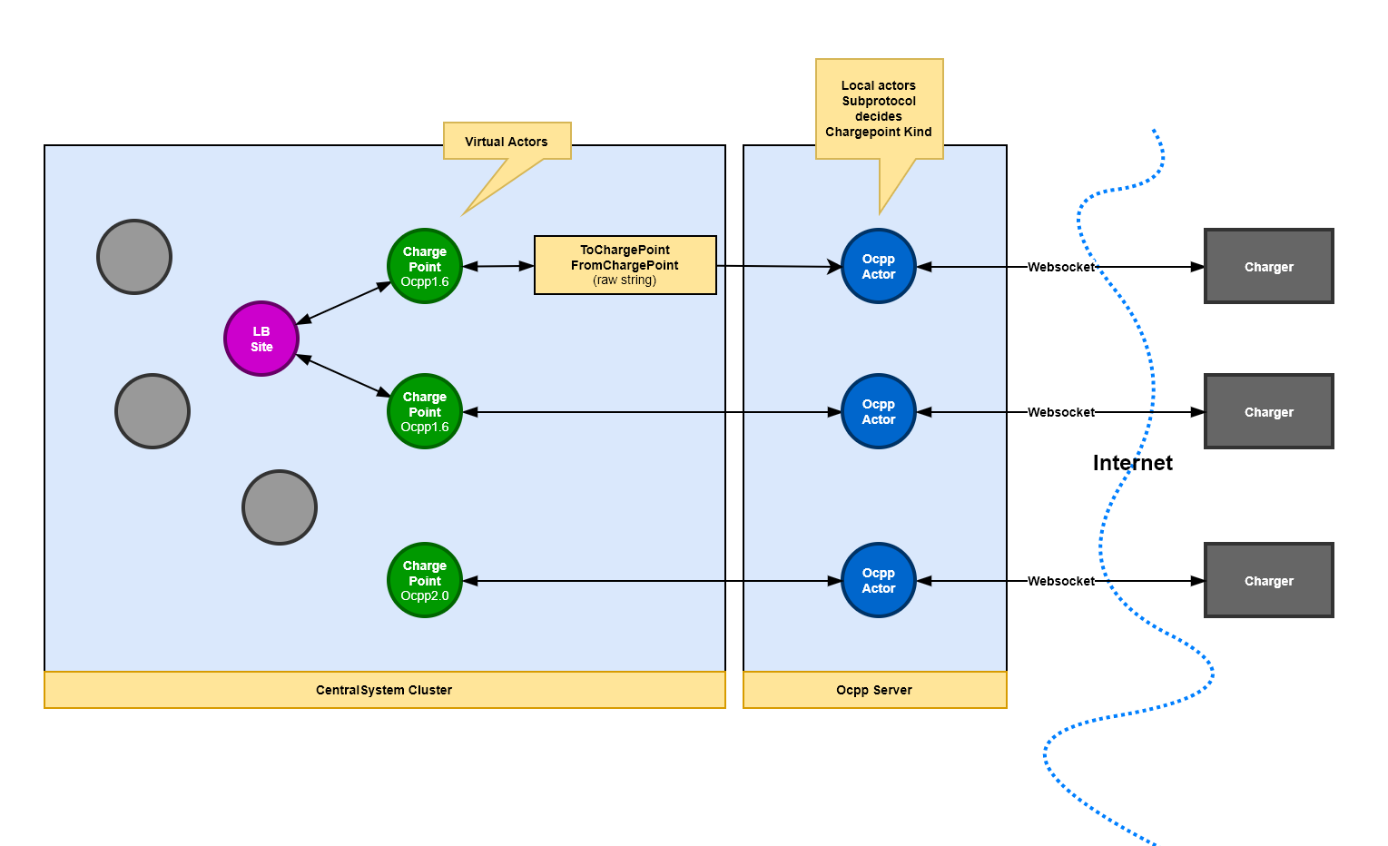

Slide 117
The End
Roger Johansson
Twitter: @rogeralsing
Github: rogeralsing
Mail: roger@asynkron.se
Github.com/rogeralsing/presentations
http://Proto.Actor

